Slide 1
Case Study: Pathfinder Learning Plans
Presentation to
PLTG
April 13, 2012
John M. Attinger

Slide 2
Overview of the Pathfinder

Slide 3
Concept
Main objections to online learning are:
Too much content
Not relevant to me
Difficult to identify relevant courses in the catalog
Pathfinder allows you to:
Build a framework of content for each user type
Convince users that the resulting content is user-specific
Track completion of learning plans

Slide 4
How the Pathfinder Works

Slide 5
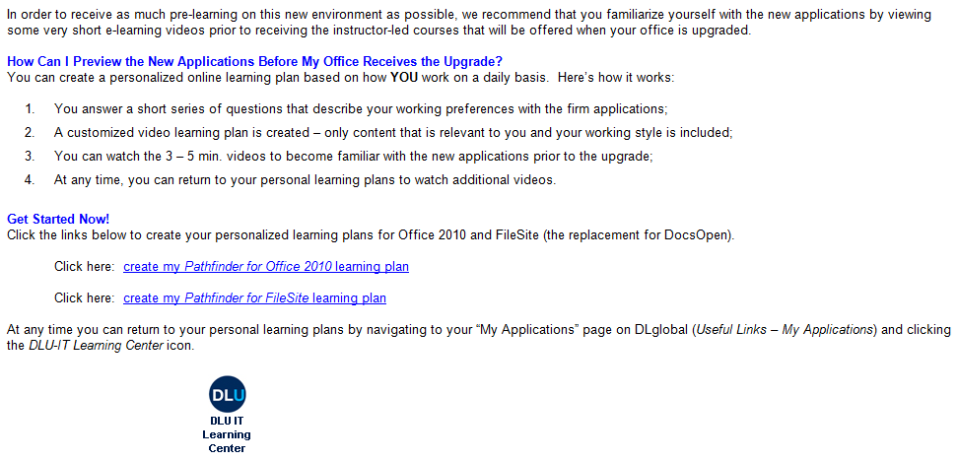
Concept Introduction

Slide 6
Concept Introduction

Slide 7
Concept Introduction

Slide 8
Pathfinder Dashboard

Slide 9
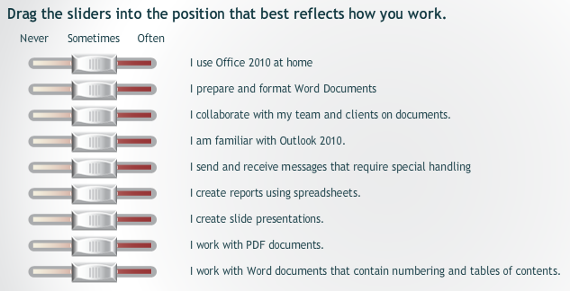
Slider Interface

Slide 10
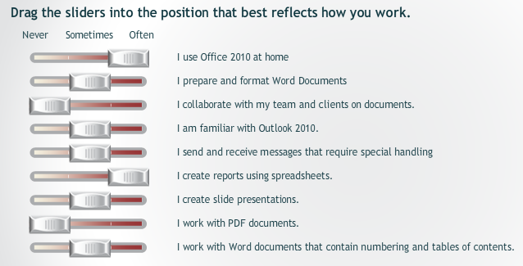
Work Statements

Slide 11
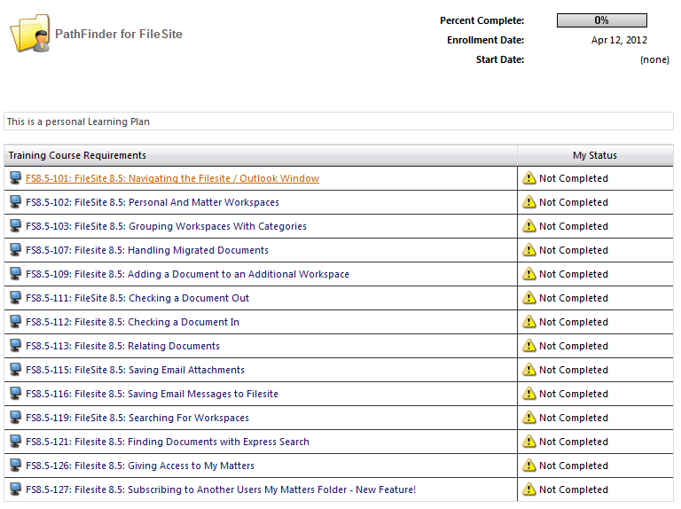
Personal Learning Plan

Slide 12
Win7 / Office 2010 Rollout Metrics

Slide 13
Overall Pathfinder Usage
2,200
509
251

Slide 14
Overall Learning Plan Breakdown
Total Learning Plans = 509

Slide 15
Learning Plan Completion Rate - Attorneys
53
55
51
43

Slide 16
Learning Plan Completion Rate – Non-Attorneys
Percent
(%)

Slide 17
Overall Course Usage

Slide 18
Courses Completion Rate

Slide 19
Lessons Learned

Slide 20
Lessons Learned
Conduct a pilot group to determine accuracy of proposed learning plans
Emphasize the personal nature of the resulting learning plans
Keep the learning plans short and targeted
Warn users that the learning plan generation process takes time
Repeat usage to leverage perceived value

Slide 21
Questions?
The material contained herein does not constitute legal advice. Prior results do not guarantee future performance. © 2012 Dewey & LeBoeuf LLP All rights reserved. Dewey & LeBoeuf LLP is a New York limited liability partnership. For further information on Dewey & LeBoeuf, please visit www.dl.com.

