Slide 1
Designing Effective
eLearning
Kevin Siegel
ksiegel@iconlogic.com
@kevin_siegel

Slide 2
Overview
Top Development Tools
The Hardware
Your time
Learner time
Engagement and Retention

Slide 3
Top Development Tools
Adobe Captivate
Articulate Storyline
TechSmith Camtasia Studio
Adobe Presenter
Articulate Presenter

Slide 4
The Hardware
Any modern PC
Any modern Mac
Lots of memory
Headset
Web Server or LMS

Slide 6
What… is the attention span of a typical goldfish?

Slide 7
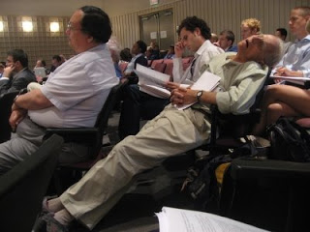

Slide 8
What… is the attention span of a typical person surfing the web?

Slide 9
Once… the learner clicks the Play button to begin an individual lesson (module), how long should it take for the learner to able to complete the lesson?

Slide 10
Edward EVERETT
Notes:
On November 19, 1863, Edward Everett was the first to speak at Gettysburg. Everett was a Massachusetts politician and a bit long-winded. His speech went on for two hours.
During Everett’s Oration, it was reported that not one person among the hundreds in attendance made a sound nor left. Everyone paid attention. (Note: There weren’t chairs provided so everyone stood.)
When Everett was finished, Abraham Lincoln stepped forward to address the crowd. In a speech that lasted a mere two minutes, Lincoln gave us probably the most memorable and certainly one of the most quoted speeches in American history.

Slide 11
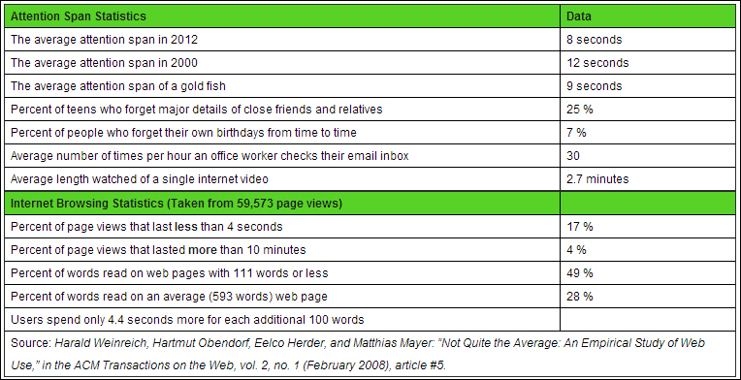
Did You Say Something?…
Source: http://www.statisticbrain.com/attention-span-statistics/

Slide 12
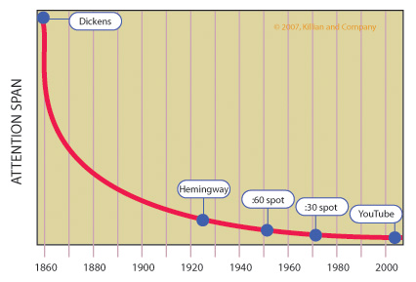
No Really, Did You Say Something?

Slide 13
Meet the Ums

Slide 14
Tell Um…

Slide 15
Teach Um…

Slide 16
Tell Um What You Taught Um…

Slide 17
Engage Um…

Slide 18
Quiz Um…

Slide 19
How Can You Engage?
Clickable Areas (Captivate, Storyline, Camtasia)
Action Verbiage (Captivate, Storyline, Camtasia)
Variables (Captivate, Storyline)
Interactions (Captivate)
Quizzes (Captivate, Storyline, Camtasia)

Slide 20
When It Comes to Das Quiz
Stick with Multiple Choice and True/False
Think Compliance & HTML5
No more than 5-10 Questions per 5-minute eLearning lesson
Don’t be mean!

Slide 26
How Long?
As a general rule, you should budget two hours of development for each minute of eLearning play time.

Slide 27
Does Not Include…
Graphic Design | Script Writing | Rehearsals | Voiceover Scripts | Audio Recording | Audio Editing | Writing Question Slides | 508 Compliance | Managing the Course (learner access/success/etc)

Slide 28
http://www.iconlogic.com/captivate-elearning-calculator-download.html

Slide 29
Samples of eLearning
Software Demonstration
Software Simulation

Slide 30
Questions? Follow-Up?
Contact Me:
Kevin Siegel
ksiegel@iconlogic.com
@kevin_siegel

